Slide 1

Basics of Functional Dependencies and Normalization for Relational Databases
Chapter # 08

Slide 2
Introduction
Levels at which we can discuss goodness of relation schemas
  Logical (or conceptual) level
  Implementation (or physical storage) level
Approaches to database design:
  Bottom-up or top-down

Slide 3
Informal Design Guidelines for Relation Schemas
Measures of quality
  Making sure attribute semantics are clear
  Reducing redundant information in tuples
  Reducing NULL values in tuples
  Disallowing possibility of generating spurious tuples

Slide 4
Semantics of the Relation Attributes
Design relation schema so that it is easy to explain its meaning
Do not combine attributes from multiple entity types and relationship types into a single relation

Slide 5
GUIDELINE 1
Informally, each tuple in a relation should represent one entity or relationship instance. (Applies to individual relations and their attributes).
-Attributes of different entities (EMPLOYEEs, DEPARTMENTs, PROJECTs) should not be mixed in the same relation
- Only foreign keys should be used to refer to other entities
- Entity and relationship attributes should be kept apart as much as possible.

Slide 6
Redundant Information in Tuples and Update
Anomalies
Grouping attributes into relation schemas
  Significant effect on storage space
Storing natural joins of base relations leads to update anomalies
Types of update anomalies:
  Insertion
  Deletion
  Modification

Slide 7
Anomalies Example
Consider the relation:
EMP_PROJ ( Emp#, Proj#, Ename, Pname, No_hours)
Update Anomaly: Changing the name of project number P1 from “Billing” to “Customer-Accounting” may cause this update to be made for all 100 employees working on project P1.

Slide 8
Anomalies Example
Insert Anomaly: Cannot insert a project unless an employee is assigned to .
Inversely - Cannot insert an employee unless an he/she is assigned to a project.
Delete Anomaly: When a project is deleted, it will result in deleting all the employees who work on that project. Alternately, if an employee is the sole employee on a project, deleting that employee would result in deleting the corresponding project

Slide 9
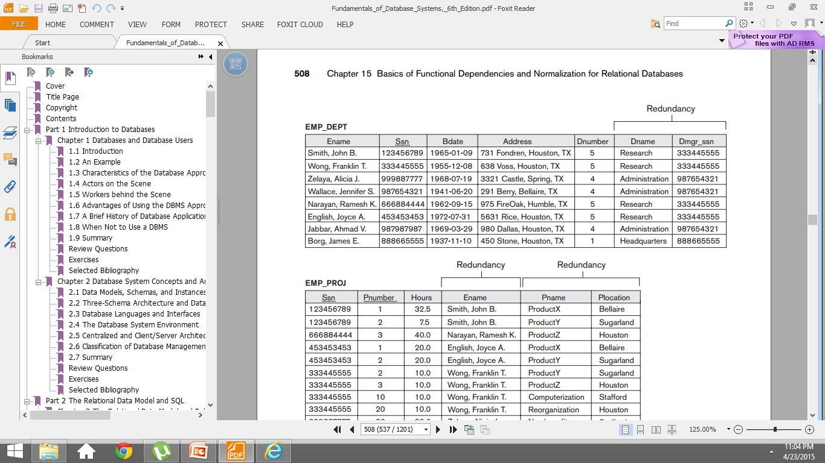

Anomalies Example

Slide 10
GUIDELINE 2
Design base relation schemas so that no update anomalies are present in the relations
If any anomalies are present:
  Note them clearly
  Make sure that the programs that update the database will operate correctly

Slide 11
NULL Values In tuple
May group many attributes together into a “fat” relation
  Can end up with many NULLs
Problems with NULLs
  Wasted storage space
  Problems understanding meaning

Slide 12
GUIDELINE 3
Relations should be designed such that their tuples will have as few NULL values as possible
Attributes that are NULL frequently could be placed in separate relations (with the primary key)
Reasons for nulls:
  attribute not applicable or invalid
  attribute value unknown (may exist)
  value known to exist, but unavailable

Slide 13
Spurious Tuples
Bad designs for a relational database may result in erroneous results for certain JOIN operations

Slide 14
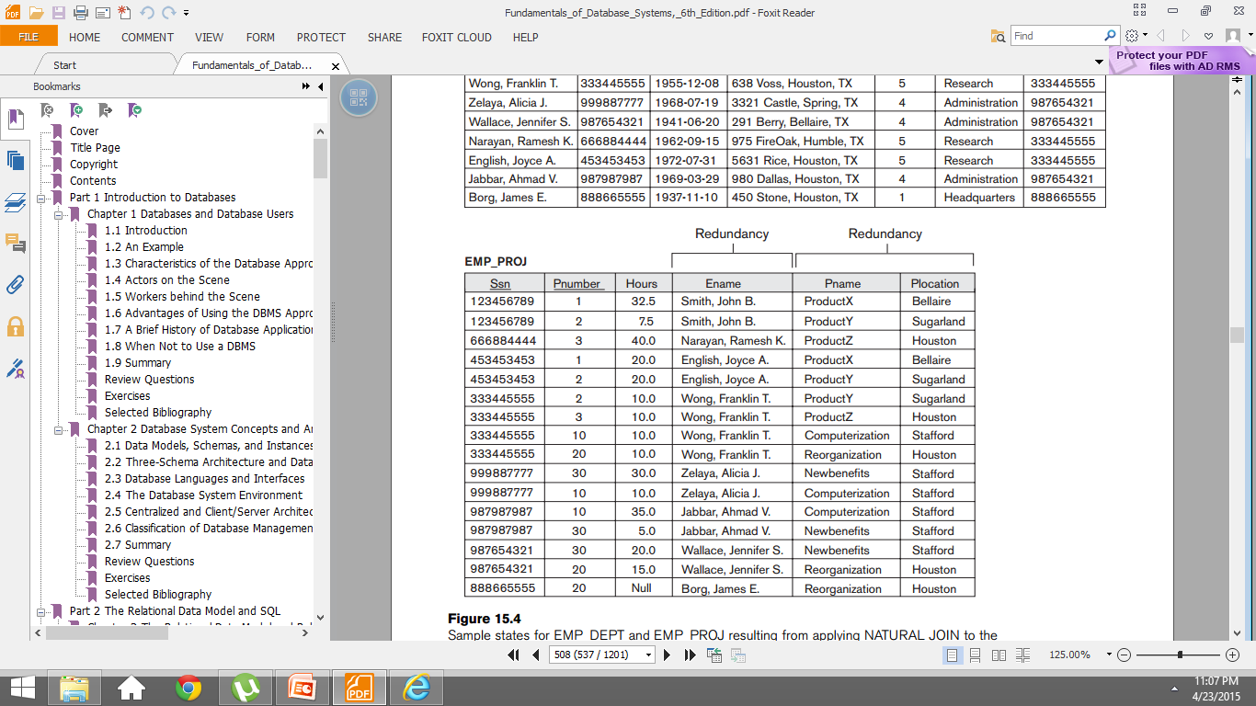
Spurious Tuples

Slide 15
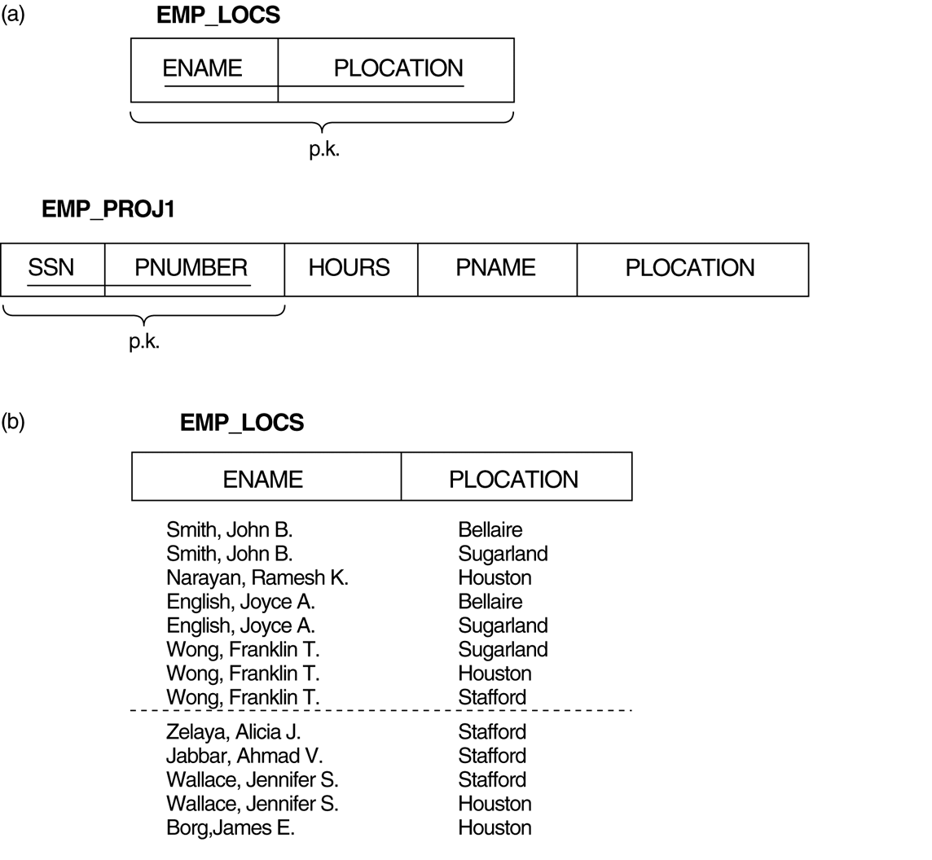
Spurious Tuples

Slide 16
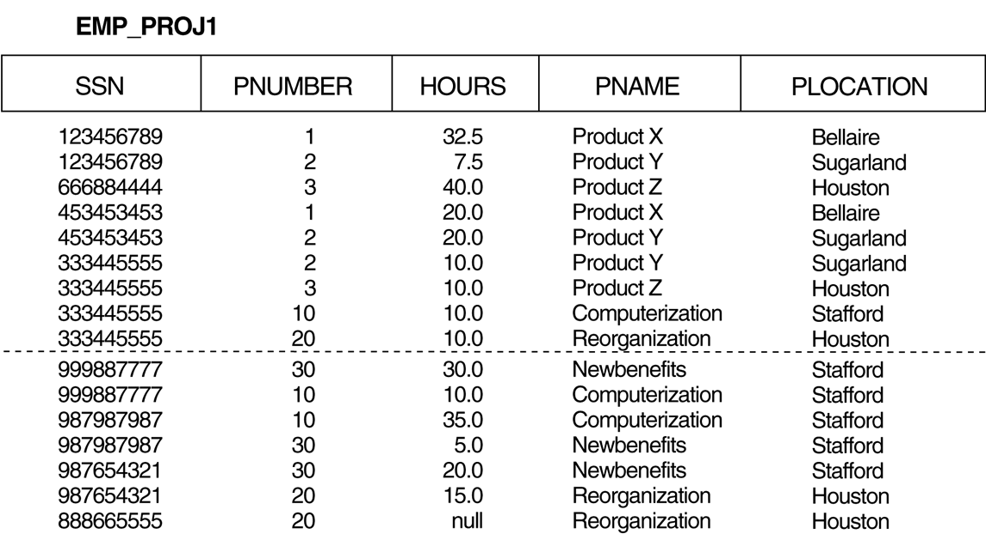
Spurious Tuples

Slide 17
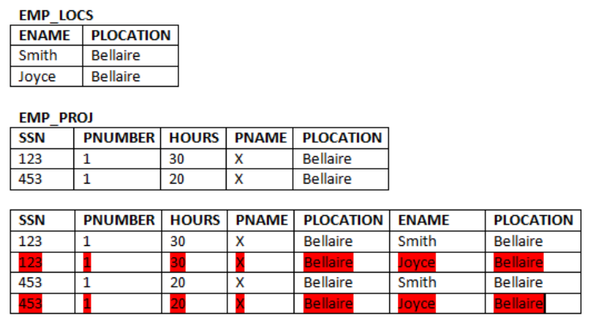
Spurious Tuples

Slide 18
GUIDELINE 4
Design relation schemas to be joined with equality conditions on attributes that are appropriately related
  Guarantees that no spurious tuples are generated
Avoid relations that contain matching attributes that are not (foreign key, primary key) combinations

Slide 19
Functional dependencies
Functional dependencies (FDs) are used to specify formal measures of the "goodness" of relational designs
FDs and keys are used to define normal forms for relations
FDs are constraints that are derived from the meaning and interrelationships of the data attributes
A set of attributes X functionally determines a set of attributes Y if the value of X determines a unique value for Y

Slide 20
Functional dependencies
A Functional Dependency describes a relationship between attributes within a single relation.
An attribute is functionally dependent on another if we can use the value of one attribute to determine the value of another.

Slide 21
Functional dependencies
X -> Y holds if whenever two tuples have the same value for X, they must have the same value for Y
For any two tuples t1 and t2 in any relation instance r(R): If t1[X]=t2[X], then t1[Y]=t2[Y]
X -> Y in R specifies a constraint on all relation instances r(R)
FDs are derived from the real-world constraints on the attributes

Slide 22
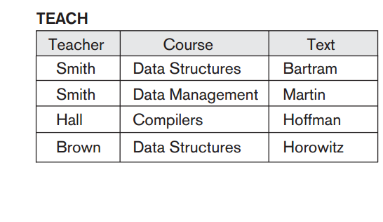
Functional dependencies

Slide 23
Functional dependencies
Student_ID → Student_Major
Student_ID, CourseNumber,Semester → Grade
Course_Number, Section → Professor, Classroom, NumberOfStudents

Slide 24
Examples of FD constraints
social security number determines employee name
SSN -> ENAME
project number determines project name and location
PNUMBER -> {PNAME, PLOCATION}
employee ssn and project number determines the hours per week that the employee works on the project
{SSN, PNUMBER} -> HOURS

Slide 25
Examples of FD constraints
An FD is a property of the attributes in the schema R
The constraint must hold on every relation instance r(R)
If K is a key of R, then K functionally determines all attributes in R (since we never have two distinct tuples with t1[K]=t2[K])

Slide 26
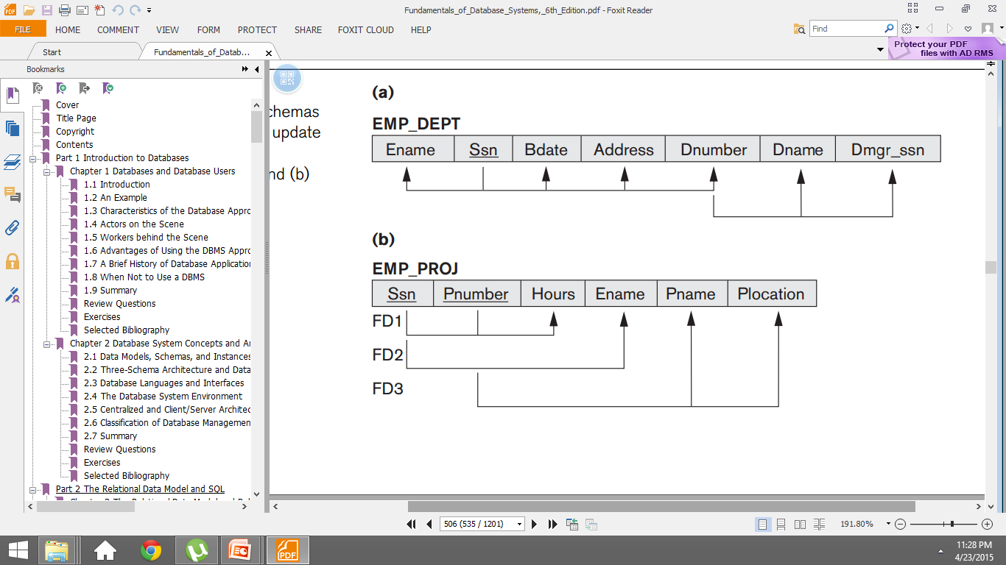
Examples of FD constraints

Slide 27
Normalization
Normalization: The process of decomposing unsatisfactory "bad" relations by breaking up their attributes into smaller relations
Normal form: Condition using keys and FDs of a relation to certify whether a relation schema is in a particular normal form

Slide 28
Definitions of Keys and Attributes Participating in Keys
A superkey of a relation schema R = {A₁, A₂, ...., A_{n}} is a set of attributes S subset-of R with the property that no two tuples t₁ and t₂ in any legal relation state r of R will have t₁[S] = t₂[S]
A key K is a superkey with the additional property that removal of any attribute from K will cause K not to be a superkey any more.

Slide 29
Definitions of Keys and Attributes Participating in Keys
If a relation schema has more than one key, each is called a candidate key. One of the candidate keys is arbitrarily designated to be the primary key, and the others are called secondary keys.
A Prime attribute must be a member of some candidate key
A Nonprime attribute is not a prime attribute—that is, it is not a member of any candidate key.

Slide 30
First Normal Form
Disallows composite attributes, multivalued attributes, and nested relations; attributes whose values for an individual tuple are non-atomic
Techniques to achieve first normal form
  Remove attribute and place in separate relation
  Expand the key
  Use several atomic attributes

Slide 31
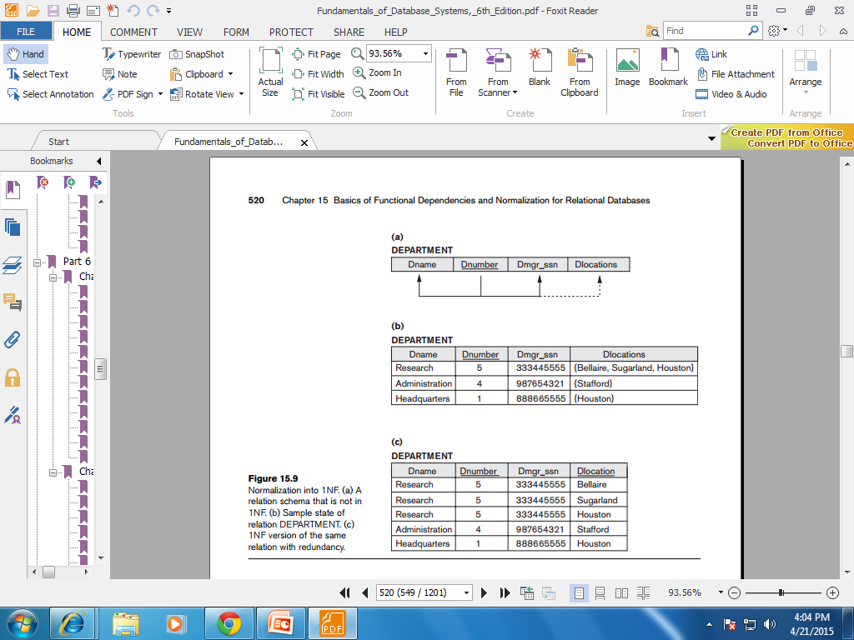
First Normal Form

Slide 32
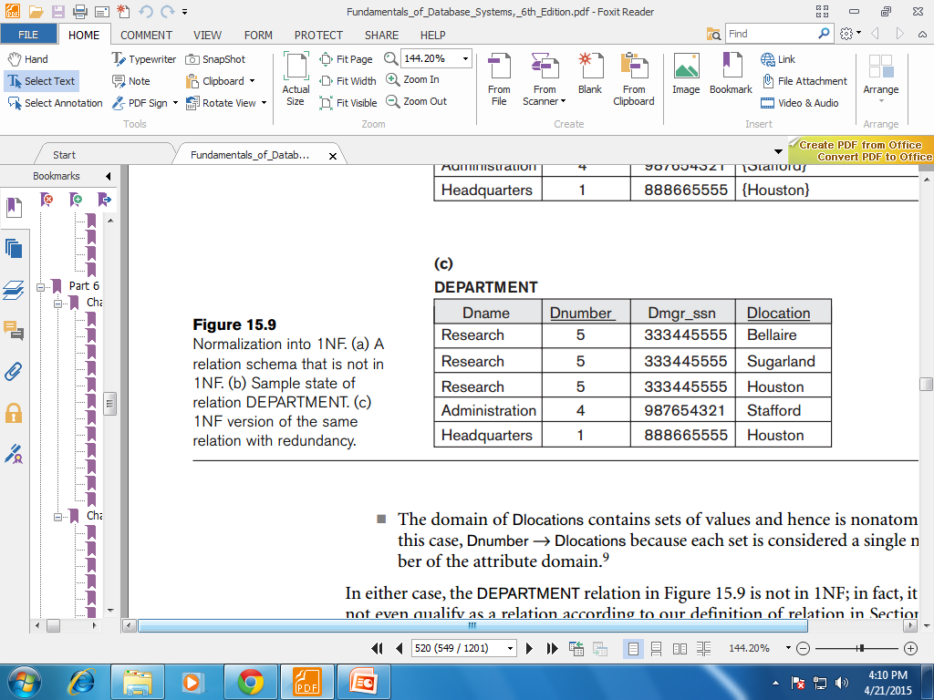
First Normal Form
Remove the attribute Dlocations that violates 1NF and place it in a separate relation DEPT_LOCATIONS along with the primary key Dnumber of DEPARTMENT
Expand the key so that there will be a separate tuple in the original
DEPARTMENT relation for each location of a DEPARTMENT

Slide 33
First Normal Form
3. If a maximum number of values is known for the attribute—for example, if it is known that at most three locations can exist for a department—replace the Dlocations attribute by three atomic attributes:Dlocation1, Dlocation2, and Dlocation3.

Slide 34
Second Normal Form
Uses the concepts of FDs, primary key
Definitions:
Prime attribute - attribute that is member of the primary key K
Full functional dependency - a FD Y -> Z where removal of any attribute from Y means the FD does not hold any more

Slide 35
Second Normal Form
- {SSN, PNUMBER} -> HOURS is a full FD since neither SSN -> HOURS nor PNUMBER -> HOURS hold
- {SSN, PNUMBER} -> ENAME is not a full FD (it is called a partial dependency ) since SSN -> ENAME also holds

Slide 36
Second Normal Form
A relation schema R is in second normal form (2NF) if every non-prime attribute A in R is fully functionally dependent on the primary key

Slide 37
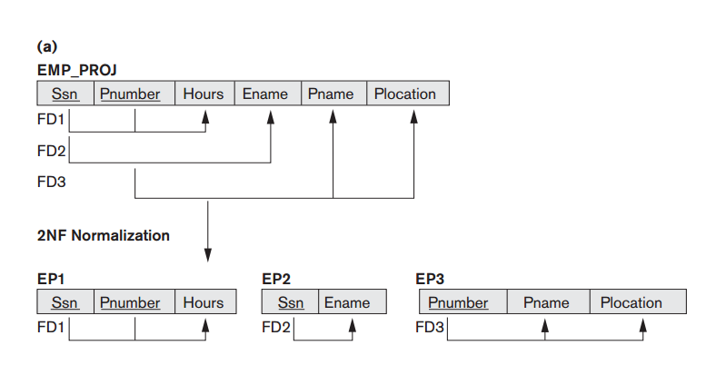
Second Normal Form

Slide 38
Third Normal Form
A relation schema R is in third normal form (3NF) if it is in 2NF and no non-prime attribute A in R is transitively dependent on the primary key

Slide 39
Third Normal Form
Third normal form (3NF)is based on the concept of transitive dependency
A functional dependency X→Y in a relation schema R is a transitive dependency if there exists a set of attributes Z in R that is neither a candidate key nor a subset or any key of R and both X→Z and Z→Y hold

Slide 40
Third Normal Form
Examples:
SSN -> DMGRSSN is a transitive FD
Since SSN -> DNUMBER
DNUMBER -> DMGRSSN
SSN -> ENAME is non-transitive
Since there is no set of attributes X where
SSN -> X and X -> ENAME

Slide 41
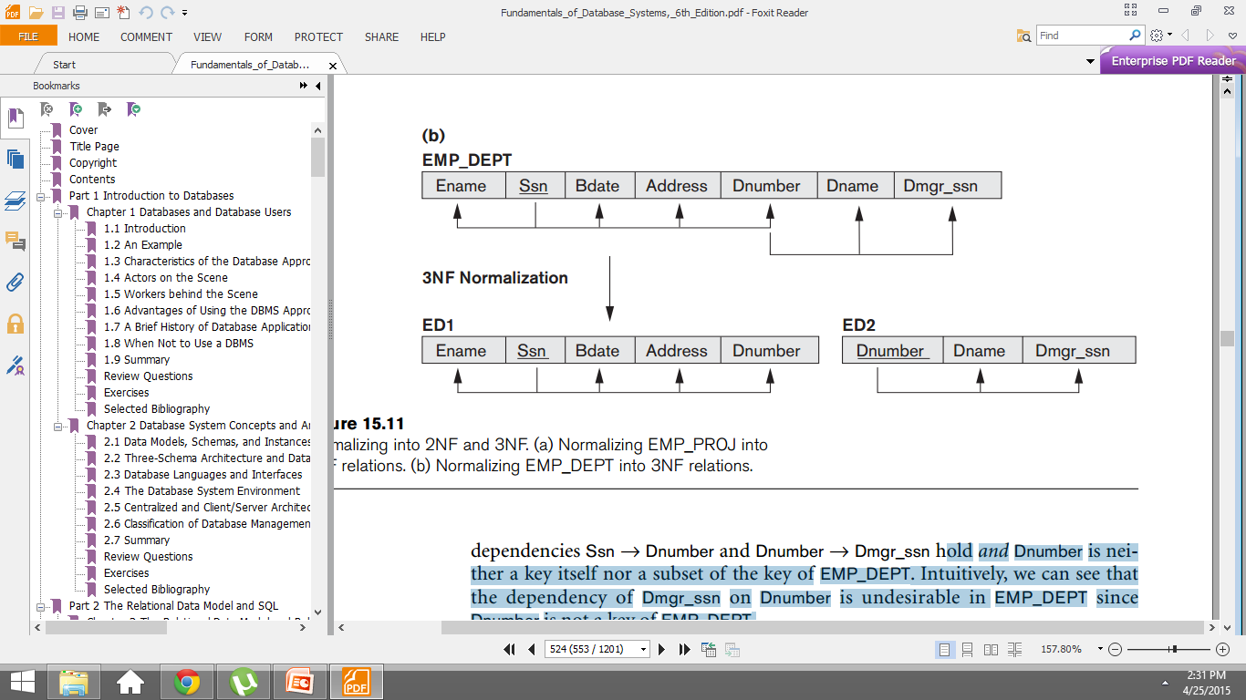
Third Normal Form

Slide 42
Third Normal Form
In X -> Y and Y -> Z, with X as the primary key, we consider this a problem only if Y is not a candidate key. When Y is a candidate key, there is no problem with the transitive dependency .
E.g., Consider EMP (SSN, Emp#, Salary ).
Here, SSN -> Emp# -> Salary and Emp# is a candidate key

Slide 43
Summary
1st normal form
All attributes depend on the key,multi value not allowed
2nd normal form
All attributes depend on the whole key
3rd normal form
All attributes depend on nothing but the key

Slide 44
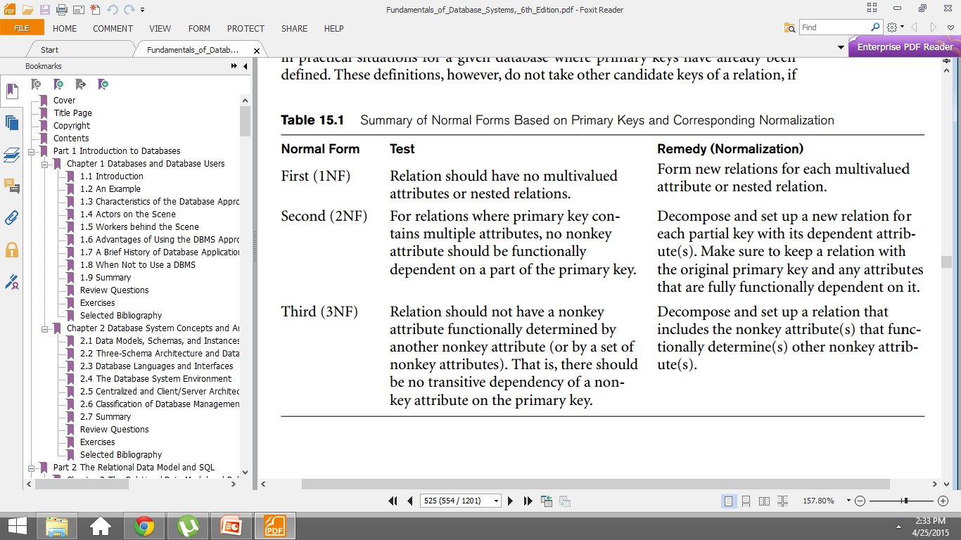
Summary of Normal Forms Based on Primary Keys and Corresponding Normalization

Slide 45
Boyce-Codd Normal Form
A relation schema R is in Boyce-Codd Normal Form
(BCNF) if whenever an FD X -> A holds in R, then X is a
superkey of R
Each normal form is strictly stronger than the previous one
Every 2NF relation is in 1NF
Every 3NF relation is in 2NF
Every BCNF relation is in 3NF
There exist relations that are in 3NF but not in BCNF
The goal is to have each relation in BCNF (or 3NF)

Slide 46
Boyce-Codd Normal Form
Every determinant in table is a candidate key
  Has same characteristics as primary key, but for some reason, not chosen to be primary key
When table contains only one candidate key, the 3NF and the BCNF are equivalent
BCNF can be violated only when table contains more than one candidate key

Slide 47
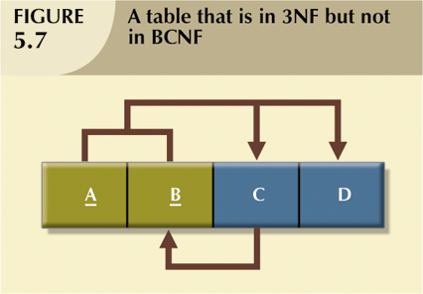
Boyce-Codd Normal Form
A table that is in 3NF but not in BCNF

Slide 48
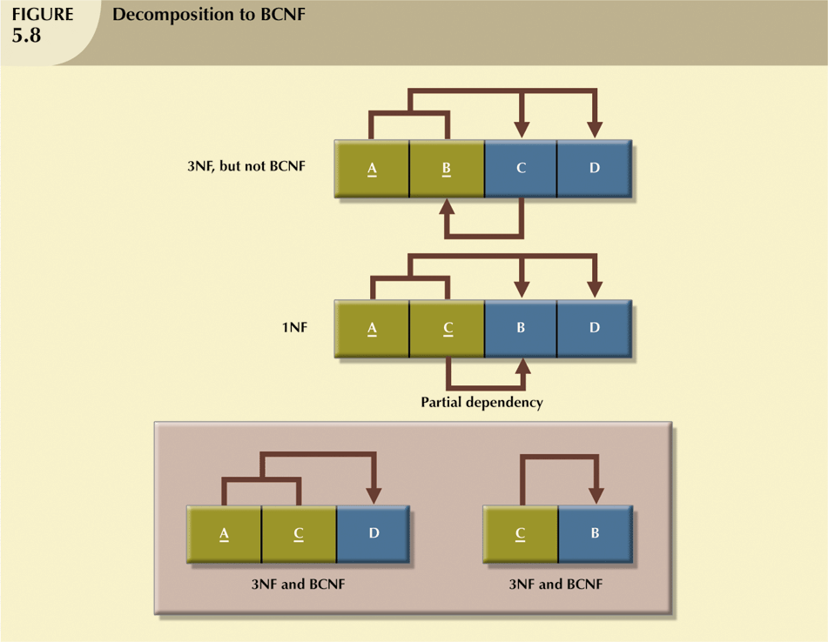
Boyce-Codd Normal Form

Slide 49
Boyce-Codd Normal Form
The difference between 3NF and BCNF is that for a functional dependency A → B,
3NF allows this dependency in a relation if B is a primary-key attribute and A is not a candidate key,
whereas BCNF insists that for this dependency to remain in a relation, A must be a candidate key.

Slide 50
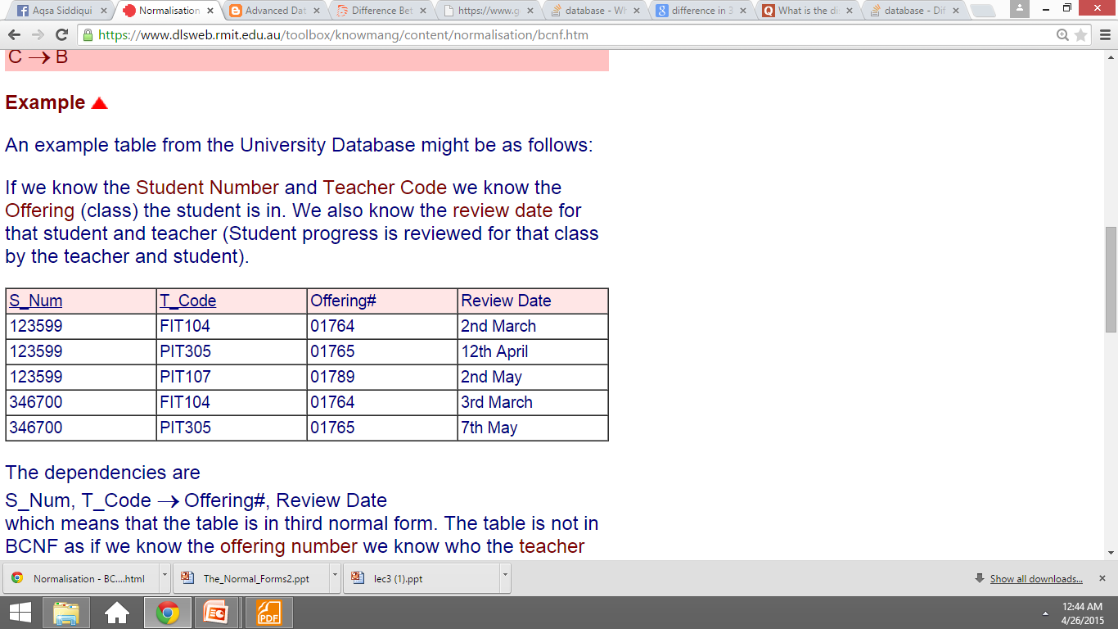
Boyce-Codd Normal Form
An example table from the University Database might be as follows:
If we know the Student Number and Teacher Code we know the Offering (class) the student is in. We also know the review date for that student and teacher (Student progress is reviewed for that class by the teacher and student).

Slide 51
Boyce-Codd Normal Form
The dependencies are
S_Num, T_Code →Offering#, Review Date
which means that the table is in third normal form.
The table is not in BCNF as if we know the offering number we know who the teacher is. Each offering can only have one teacher!
Offering# → T_Code
A non key attribute is a determinant.

Slide 52
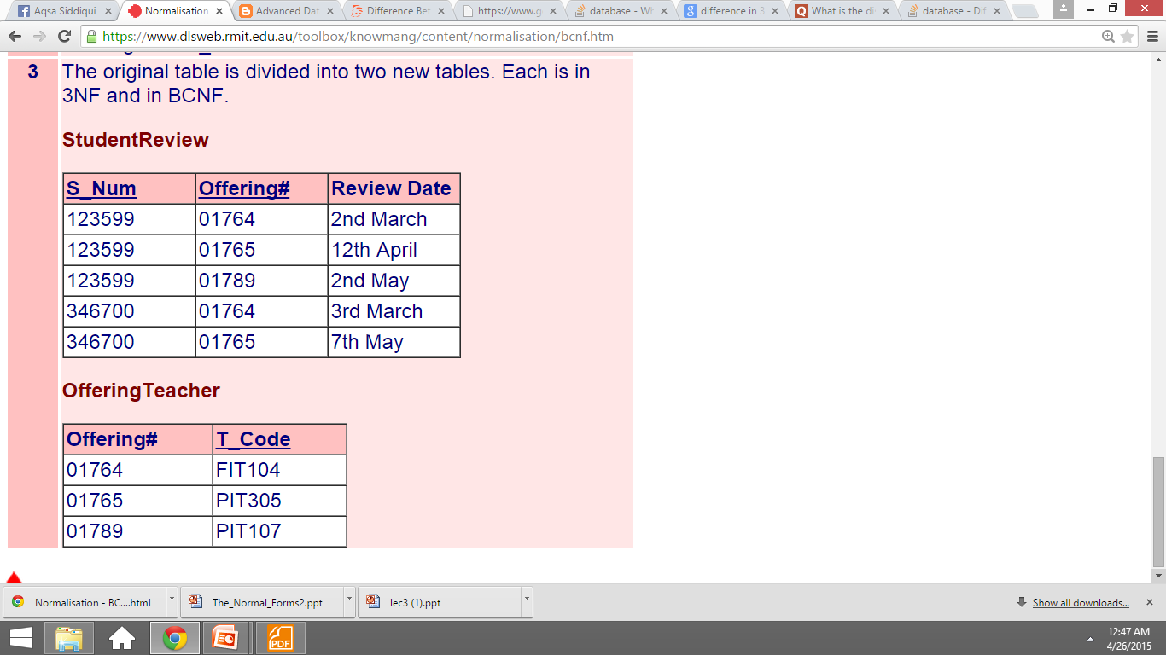
Boyce-Codd Normal Form

